Slide 1
Embedded Image Processing on FPGA
Brian Kinsella
Supervised by Dr Fearghal Morgan

Slide 2
Project Guidelines
Overview:
  To develop a range of image processing techniques for implementation on FPGA
  Compare results to those achieved using Texas Instruments implementation
  Performance, cost, power and ease of implementation will be compared

Slide 3
Image Processing Techniques
Algorithms:
  Histogram
  Histogram Differential Equation
  Single Channel Thresholding
  Contrast Stretching

Slide 4
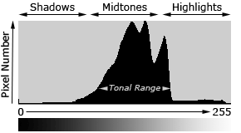
Histogram
Graphical representation of the distribution of pixels in an image over the grey-level scale
Very useful in extracting information about the contrast of the image

Slide 5
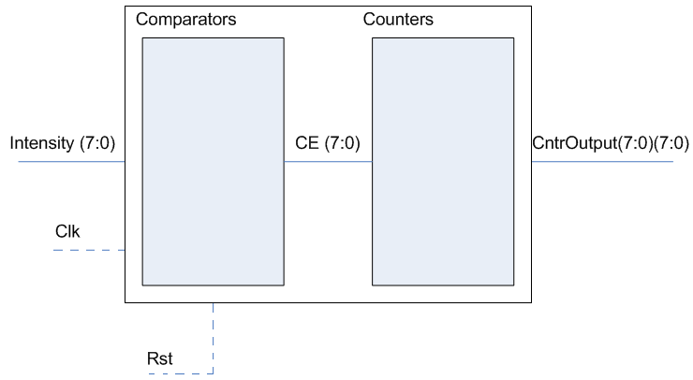
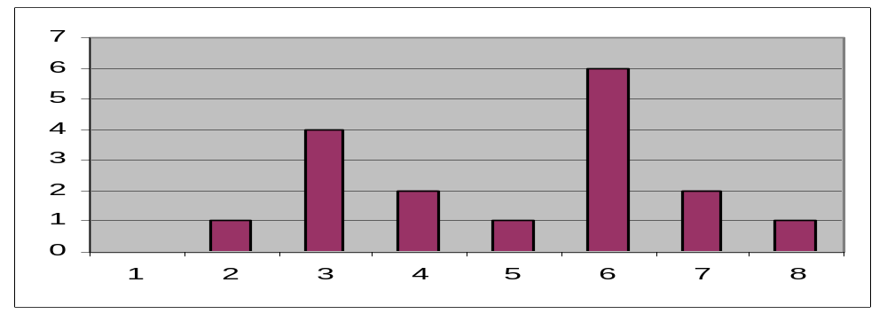
Operation

Slide 6
Histogram Differential Equation
Differential interpretation of the histogram
Useful in the determination of maxima and minima in the graph
Based on formula:
  H’(x) = H(x) – H(x-1)
Val | 8 | 12 | 14 | 6 | 2 | 0 | 5 | 7
Res | 8-x | 4 | 2 | -8 | -4 | -2 | 5 | 2

Slide 7
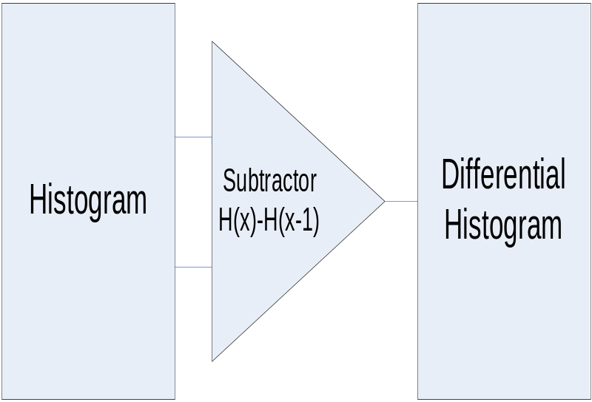
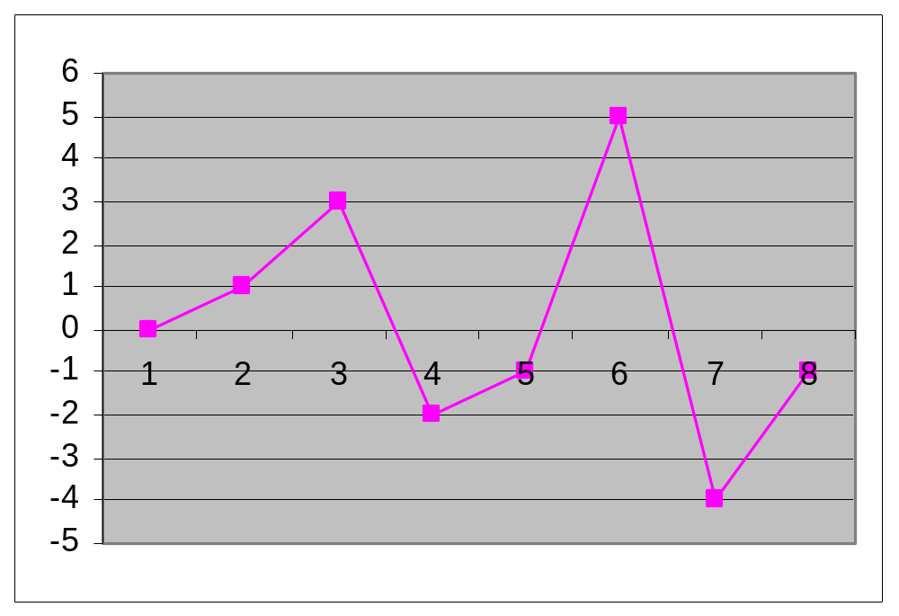
Operation

Slide 8
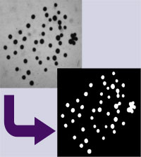
Single Channel Thresholding
Choosing a threshold value to separate objects in an image
Useful when separating an object from its background
Makes the pixels which are darker than the threshold value black, and the lighter pixels white

Slide 9
Operation
MIN
MAX

Slide 10

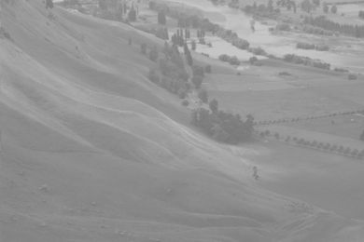
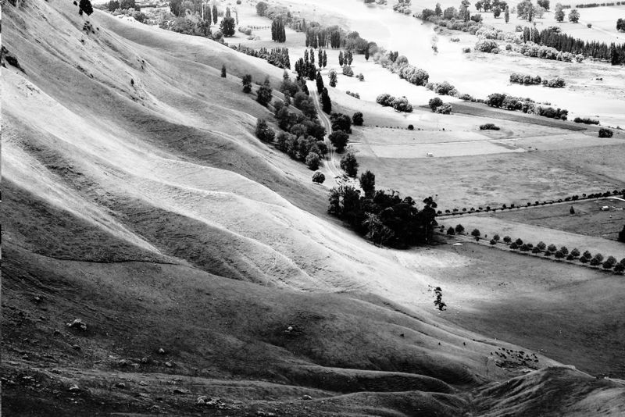
Contrast Stretching
Histogram equalisation affects the contrast of an image based on its histogram
The image is equalised making the light pixels lighter and the dark pixels darker
Results in a flatter histogram, with higher contrast

Slide 11
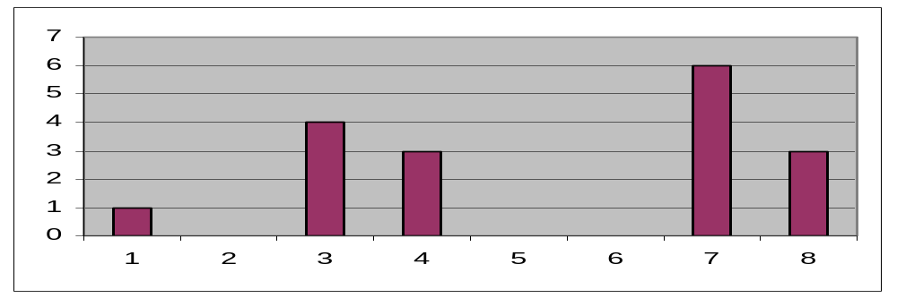
Operation
Image Histogram
Equalised Histogram

Slide 12
Progress
Histogram coded and simulated
Histogram differential coded and simulated
Working on thresholding algorithm
Equalised histogram coded, not simulated

Slide 13
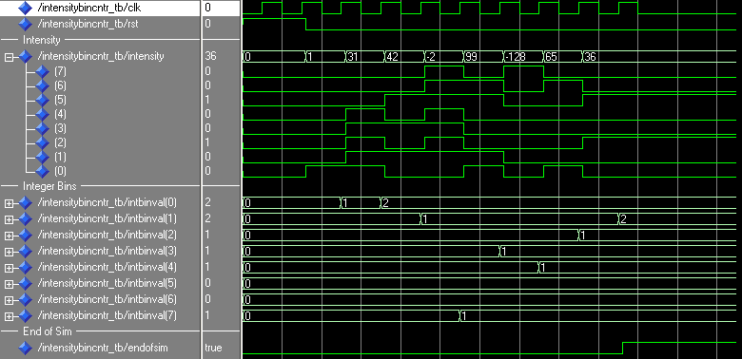
Waveforms - Histogram

Slide 14
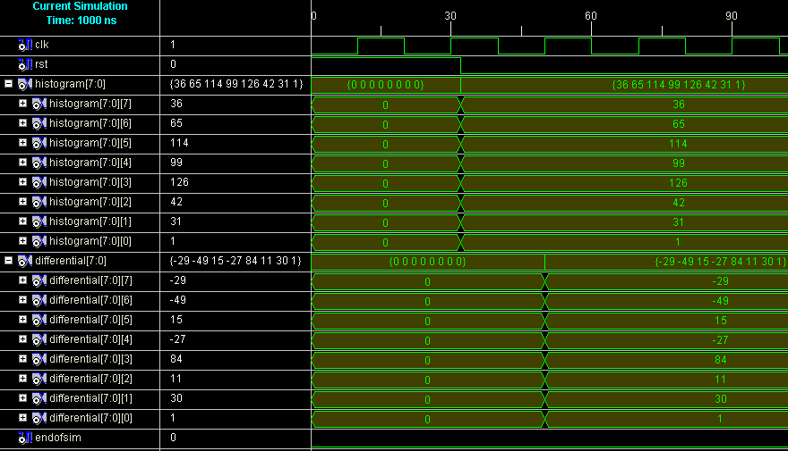
Histogram Differential

Slide 15
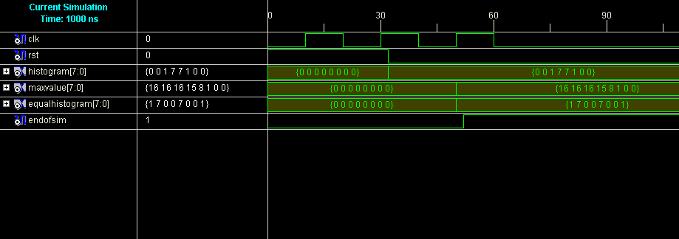
Equalised Histogram

